Slide 1
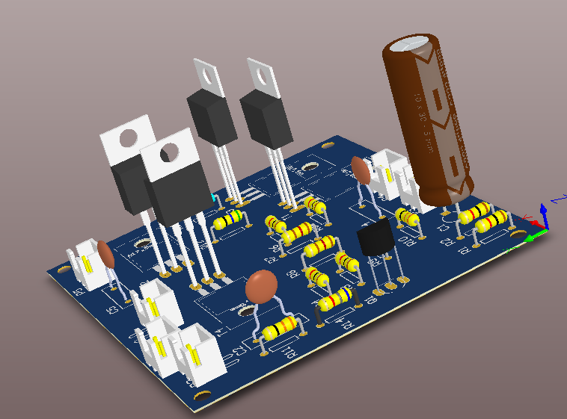
High Frequency Amplifier
Group 9

Slide 2
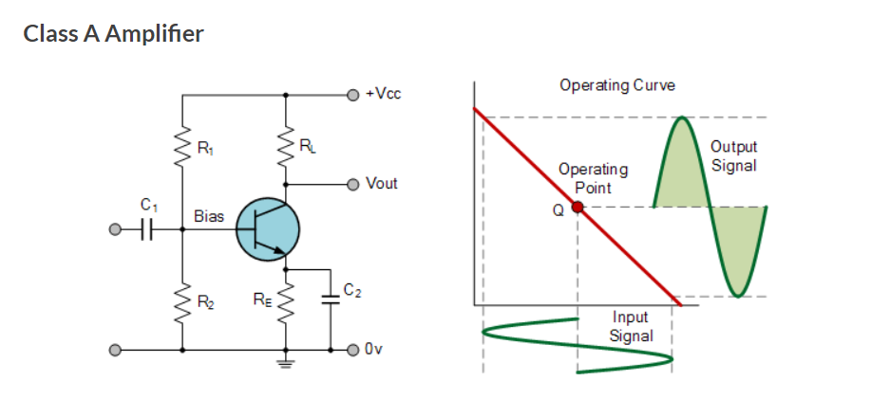
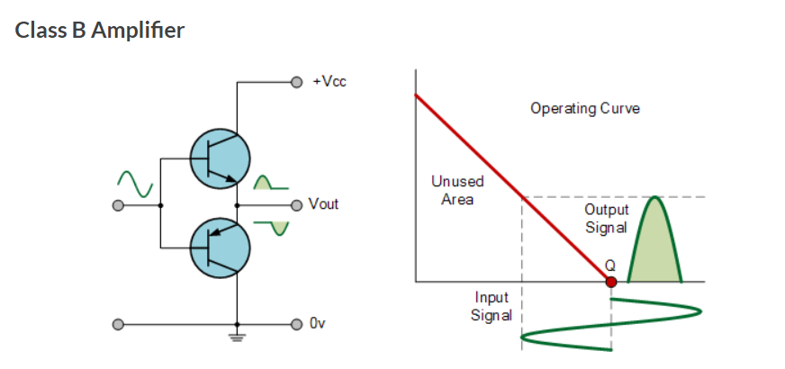
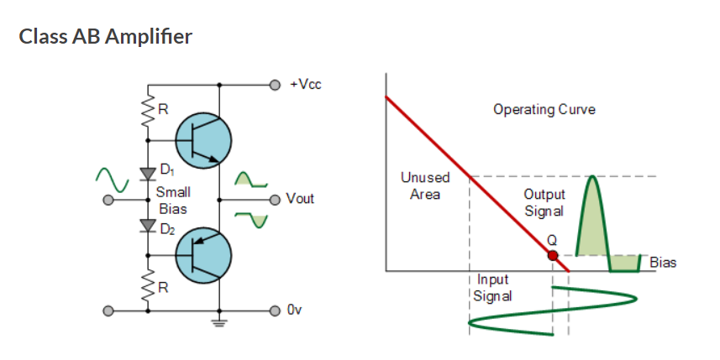
Brainstorming Sessions

Slide 3
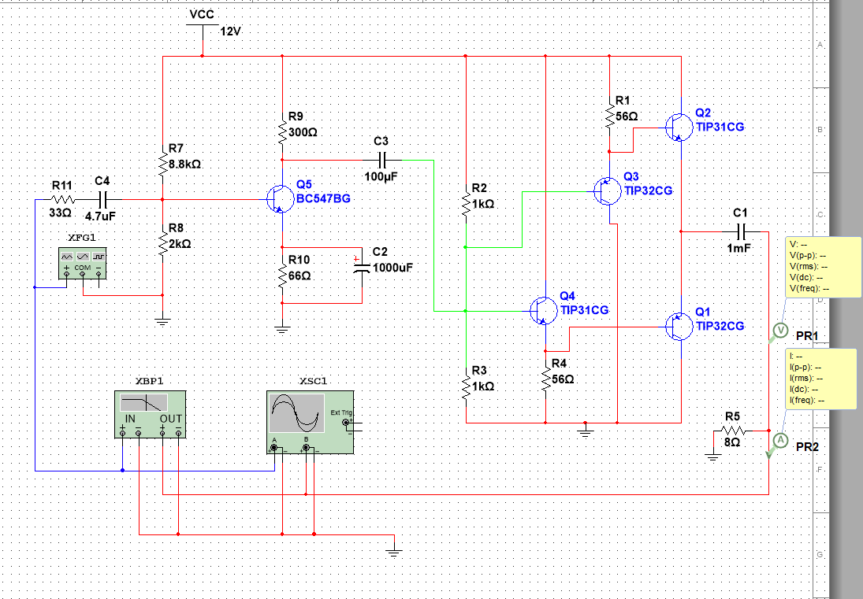
Circuit Diagram

Slide 4
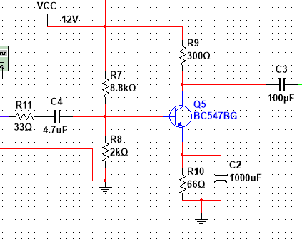


Calculations – Stage 1
Resistor Selection
$β=245$ (Experimental value)
I_{c} = 20 mA (By observing datasheet)
V_{CE} = 5V (Design Assumption)
Load line :
I_{c = -}$\frac{1}{R}$ * V_{CE} + $\frac{12}{R}$ ( R= R_{E}+R_{C})
R_{E}+R_{C} $≈$ 360
$∴$ R_{c} = 300 ohm R_{E} = 66 ohm
Capacitor Selection
20 KHz = f_{min} R_{E} = 66 ohm
X_{C2} < $\frac{1}{10}$* R_{E}
$\frac{1}{2πfc}$ < $\frac{1}{10}$ * 66
C > 1.2 * 10⁻⁶ F
$∴$ C = 1000 $μ$F

Slide 5
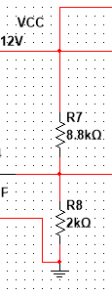

Biasing Resistors Selection
across R_{E}
V=IR
V_{E} -0 = 20mA * 66 ohm
V_{E} = 1.32 V
Since V_{BE} = 0.7 V_{B} = 2.02 V
By Potential dividing rule
2.02 = (R₈ / R₈ + R₇ ) * 12
R₇ / R₈ = 4.94059
$∴$ R₈ = 2 K ohm R₇ = 8.8 K ohm

Slide 6

AC Analysis
For first stage
r_{π} = $26∗\frac{238}{20}$ $β≈238$
r_{π} = 309.4 ohm
(8.8k,2k, r_{π} are parallel to each other and 33 ohm is series to this parallel combination)
Z_{in} = (8.8K//2K// r_{π}) + 33 ohm
Z_{in} = 293.03 ohm
Open cct voltage gain
A_{vo} $≈$ ($β∗R$_{c})/ Z_{in}
A_{vo} $≈$ $\frac{238∗300}{293.03}$ $≈$ 243.66

Slide 7
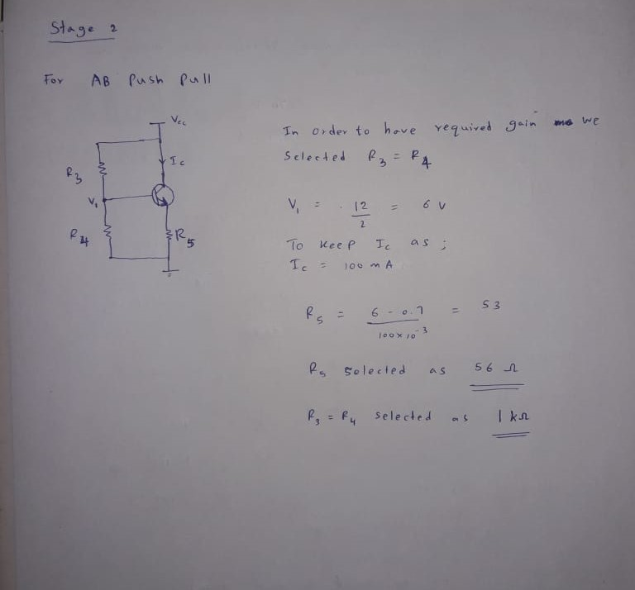
Stage - 2

Slide 8
RESULTS OBTAINED BY SIMUALTION
Parameter | Conditions | Min | Typ | Max | Unit
Operating Supply Voltage |  |  |  | 12 | V
Input Voltage (pk-pk) |  |  |  | 0.1 | V
Open Circuit Voltage Gain |  |  | 43.5
Voltage Gain | R_{L} = 8Ω |  | 42.5
Power Gain |  |  | 33.3805 |  | dB
Bandwidth |  |  | 815.11 |  | kHz
Power Output | R_{L} = 8Ω |  |  | 312 | mW
Load Current | R_{L} = 8Ω |  |  | 197 | mA

Slide 9
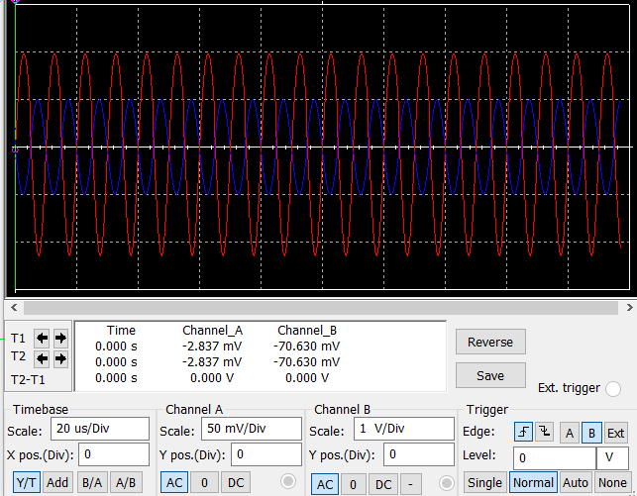
Waveforms Input – Channel A (blue) Output - Channel B (Red)

Slide 10
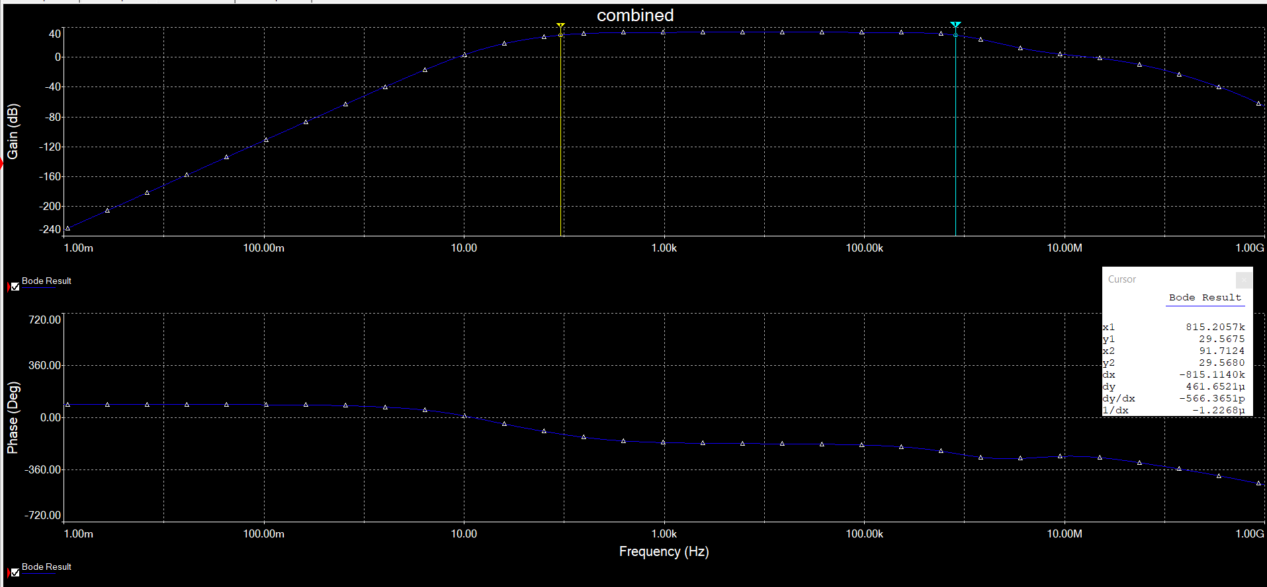
Frequency Response

Slide 11
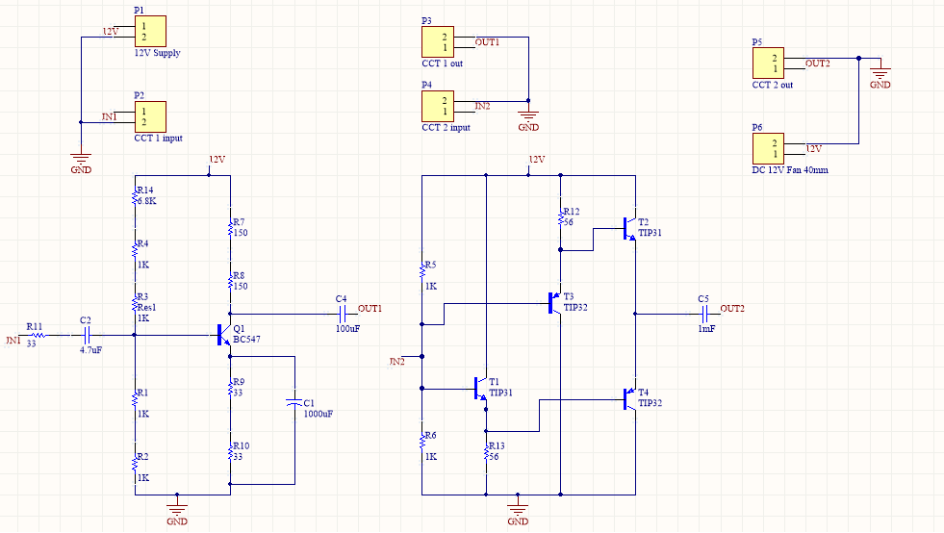
Schematic and PCB Layout

Slide 12
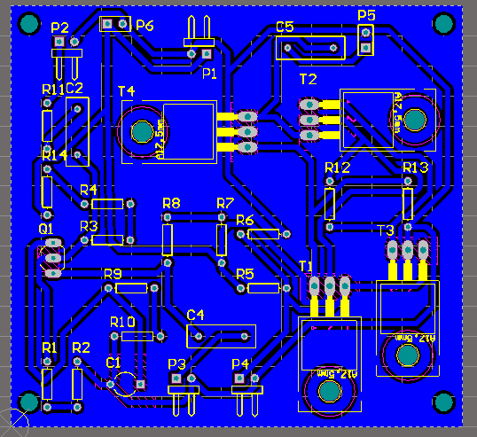
Schematic and PCB Layout
Schematic and PCB are designed with Altium 16.
Additionally, 12V DC fan is used
Two circuits have separate inputs and outputs.
70mm*75mm single layer PCB
PCB manufacturing method : Laser cutting (Engraving)

Slide 13
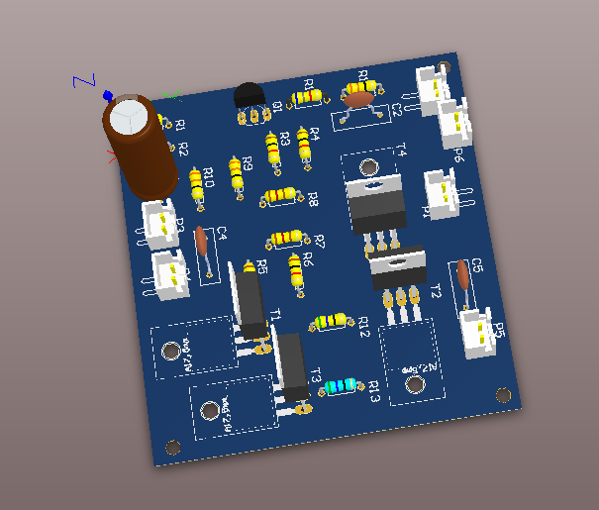

Slide 14
ALTERNATIVE METHODS
Voltage Biasing
Resistor Biasing
Diode Biasing

Slide 15
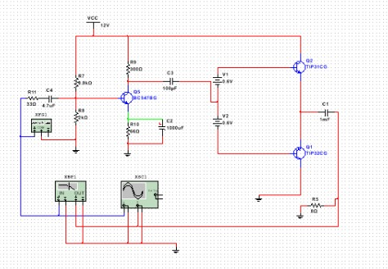
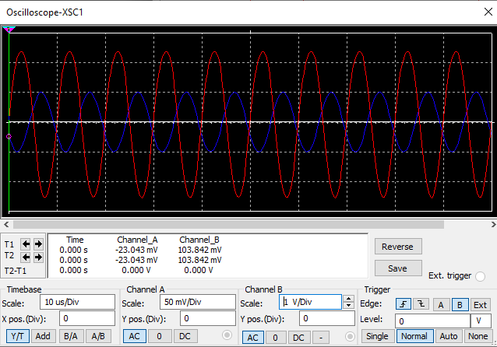
Voltage Biasing
Drawbacks
It is not practical to have extra batteries within the amplifiers output stage design

Slide 16
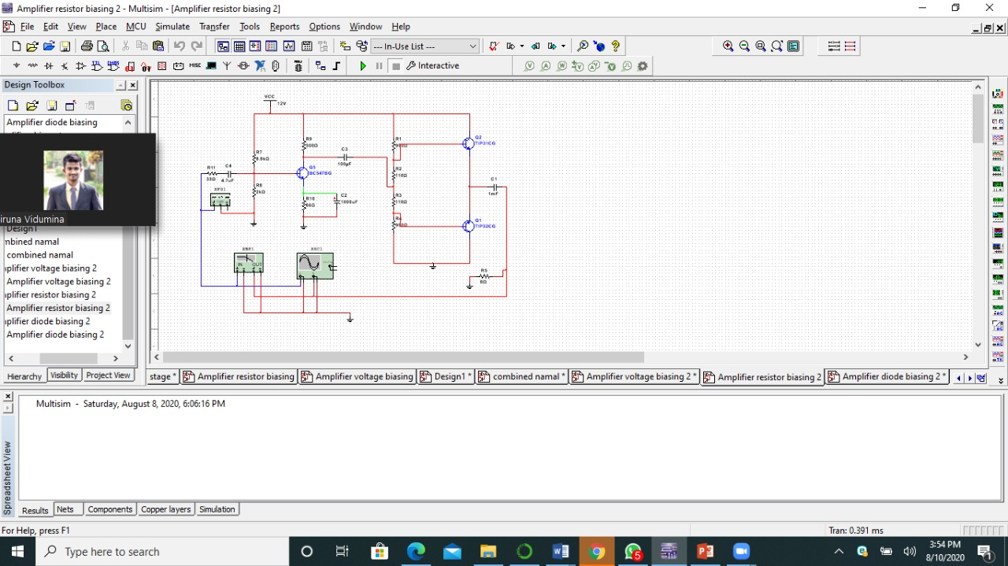
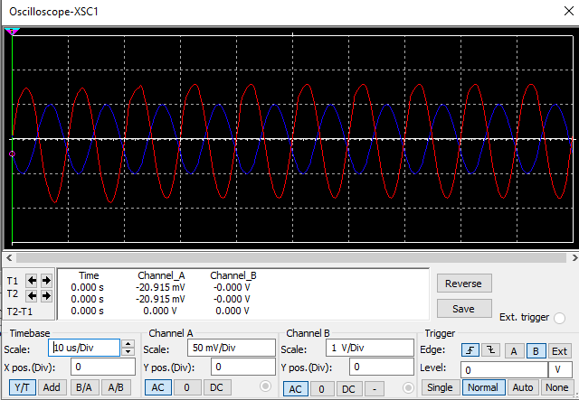
Resistor Biasing
Drawbacks
Comparatively the gain is low.
Finding the exact resistor combination within the voltage divider network is troublesome.(solution: adjustable resistor set)
Since the biasing resistors’ resistance depend on the operating temperature, small change in the temperature may lead for a change in the quicent collector current.

Slide 17
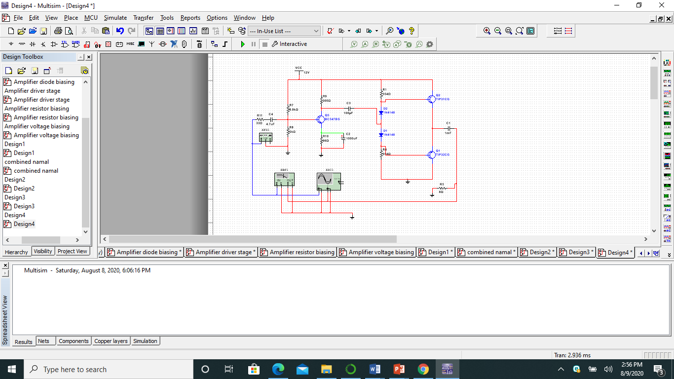
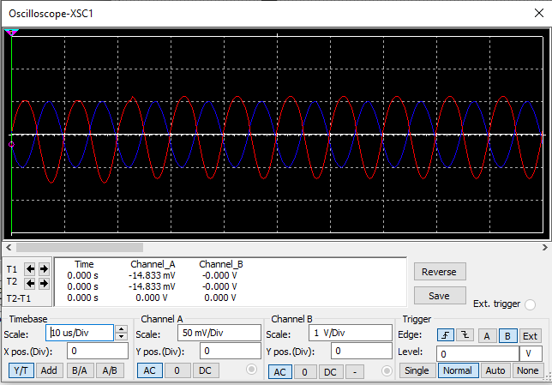
Diode Biasing
Drawbacks
Comparatively the gain is low.
Cannot be accurate about diode bias being 0.7V.

Slide 18
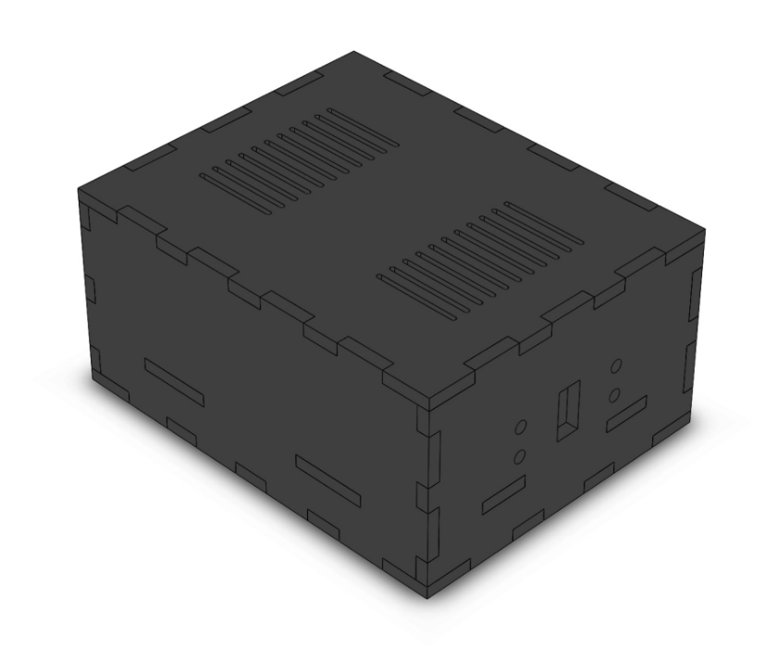
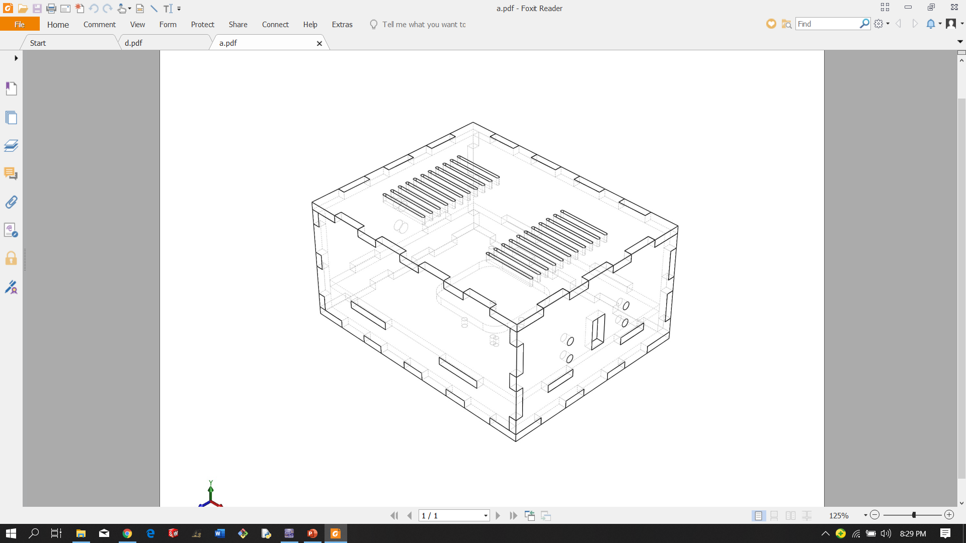
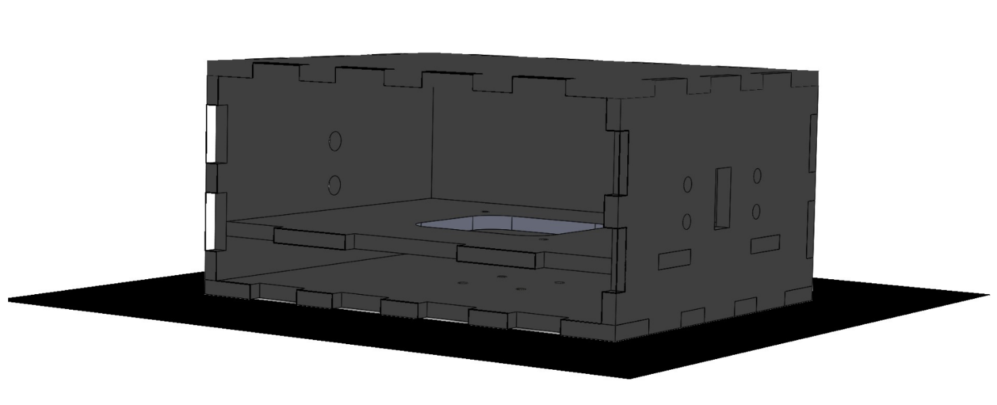
Enclosure Design

Slide 19
Work delegation
Name | Work done
K.N.S.Fernando | Circuit design, calculation
W.A.S.N.Jayawardena | Circuit simulations, calculation
R.G.H.V.Ratnayake | Enclosure design , simulation
G.K.H.Nadeeshan | Schematic & PCB, circuit design

